Slide 1
DBMS Technical Presentation
CASE-BASED SCENARIOS BY IDENTIFYING ENTITIES AND
RELATIONSHIPS.
CSA0509-DBMS
Presented by, CH. Durga Prasad(192425305)
Guided by, Dr. R . Kesavan

Slide 2
1.CREATE AND PRESENT AN ER DIAGRAM FOR AN ONLINE LIBRARY
SYSTEM, EXPLAINING EACH COMPONENT CLEARLY.
Online Library System is a computerized system that manages books, members, and library operations efficiently.
It provides a centralized database for storing book details, member information, and transaction records.
The system automates processes such as book search, issue, return, and fine calculation, reducing manual effort.
An ER Diagram visually represents the entities, attributes, and relationships involved in the library database.

Slide 3
ER DIAGRAM COMPONENTS
Entities: Real-world object (Book, Member)
Member
Book
Librarian
Loan
Attributes: Describes an entity
Member ID, Name
Book ID, Title
Loan Date, Return Date
Relationships: Connects entities
Member borrows Book
Librarian manages Loan
Primary Key: Unique identifier (Book ID, Member ID)

Slide 4
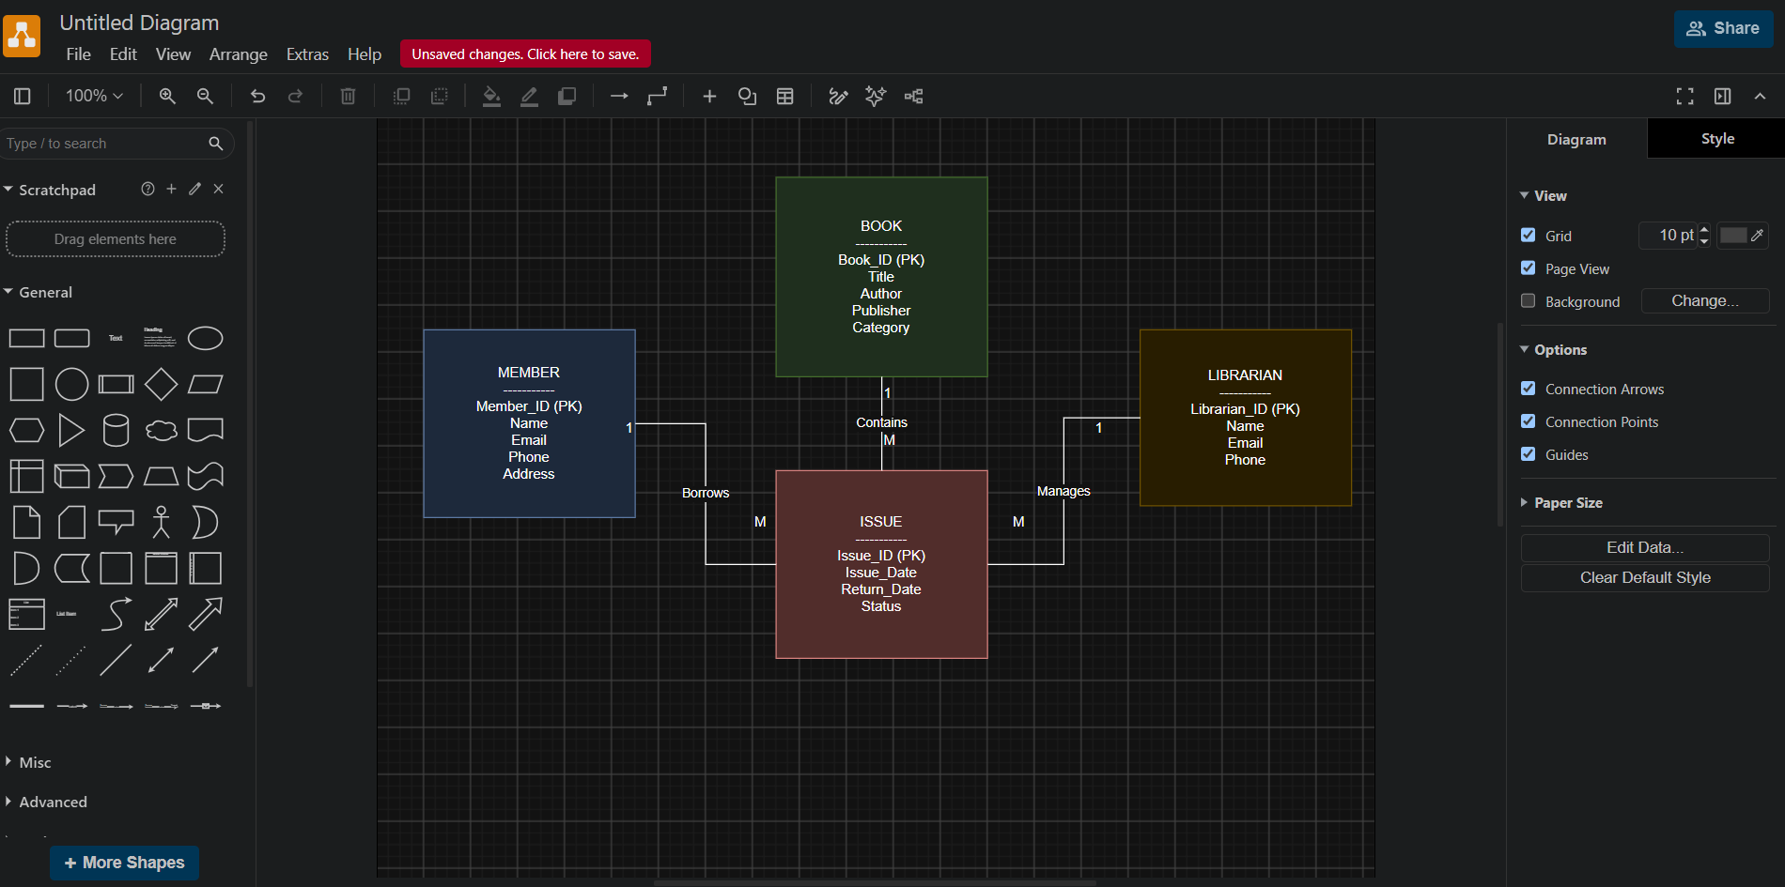
ER DIAGRAM

Slide 5
2.PREPARE A PRESENTATION ON THE EER MODEL, DEMONSTRATING GENERALIZATION AND SPECIALIZATION WITH A UNIVERSITY CASE
The Enhanced Entity-Relationship (EER) Model extends the traditional ER model with advanced modeling features.
It provides concepts such as generalization, specialization, and inheritance to represent complex real-world scenarios.
The EER model helps reduce data redundancy by allowing common attributes to be shared among related entities.
In a University Management System, a common entity like Person can be specialized into Student, Faculty, and Staff.

Slide 6
UNIVERSITY CASE STUDY
Superclass
Person
Specialized Subclasses
Student
Faculty
Staff
Each subclass inherits:
Person ID
Name
Address
Additional attributes:
Student → Semester
Faculty → Department
Staff → Designation

Slide 7
GENERALIZATION AND SPECIALIZATION
SPECIALIZATION
Divides one entity into multiple subgroups.
Example: Person → Student, Faculty, Staff.
GENERALIZATION
Combines similar entities into one superclass.
Reduces duplication of common attributes.
Makes the database easier to maintain.
Improves data organization.

Slide 8
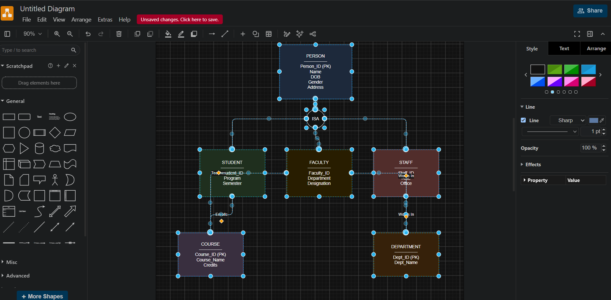
EER DIAGRAM

Slide 9
3.PRESENT THE CONCEPT OF DATA INDEPENDENCE (LOGICAL AND
PHYSICAL) AND ITS SIGNIFICANCE IN DBMS ARCHITECTURE.
Data Independence is the ability to change the database schema without affecting application programs.
It is a key feature of the three-level DBMS architecture, ensuring separation between data storage and user applications.
Data independence is classified into Logical Data Independence and Physical Data Independence.
Logical Data Independence allows changes to the conceptual schema without affecting external views or application programs.

Slide 10
TYPES OF DATA INDEPENDENCE
Physical Data Independence
Changes physical storage methods.
Logical schema remains unchanged.
Example: Changing file organization.
Logical Data Independence
Changes logical database structure.
User applications continue working.
Example: Adding a new attribute.

Slide 11
IMPORTANCE OF DATA INDEPENDENCE
Simplifies database maintenance.
Reduces application modifications.
Supports future database expansion.
Improves system performance.
Protects user applications from internal changes.
Makes database management more efficient.

Slide 12
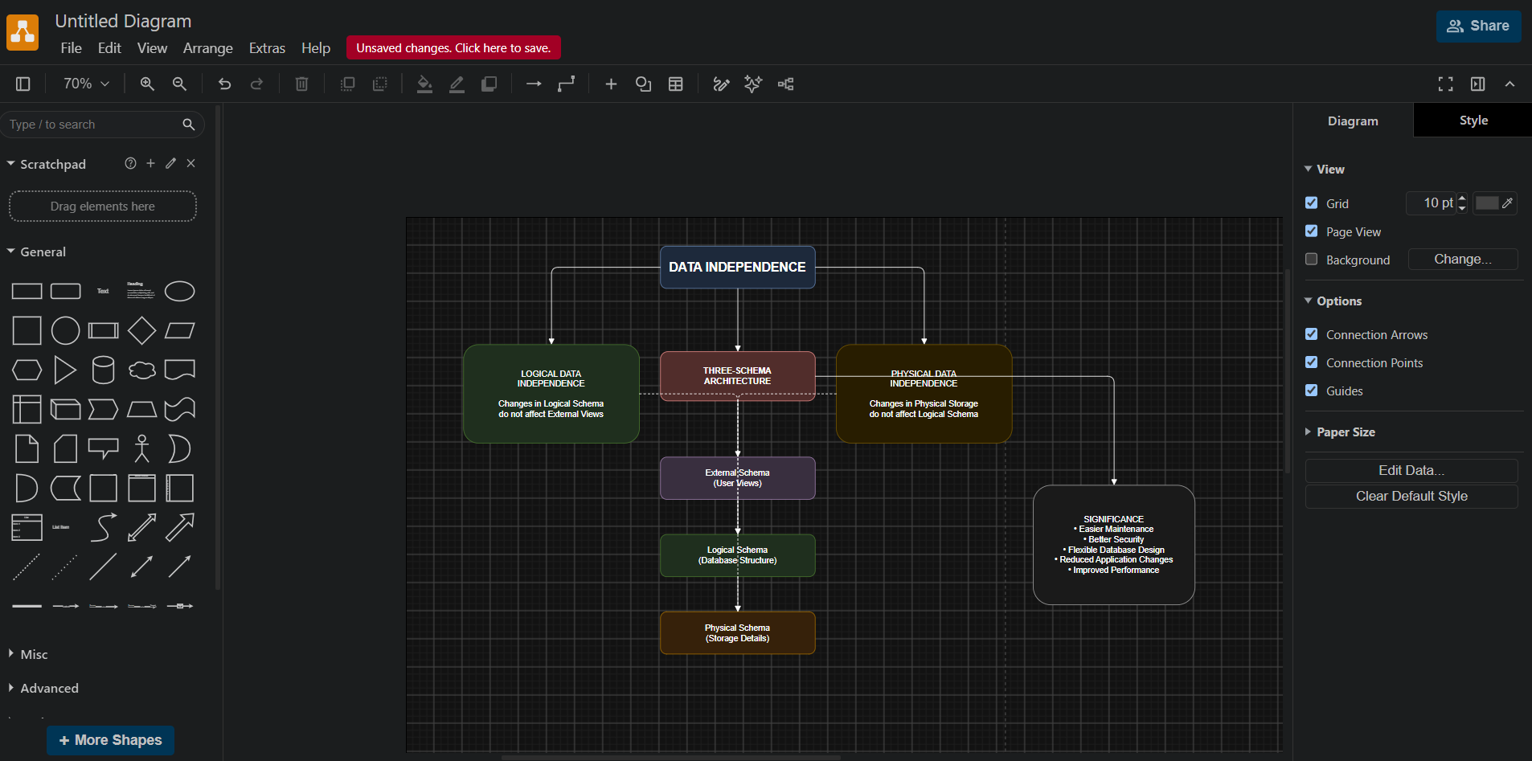

Slide 13
4.DELIVER A TECHNICAL PRESENTATION ON THE SOFTWARE COMPONENTS
OF A DBMS, EXPLAINING QUERY PROCESSOR, STORAGE MANAGER,
AND TRANSACTION MANAGER.
A DBMS is software used to store, organize, and manage data efficiently.
It consists of different software components that work together to process database operations.
The Query Processor interprets and executes SQL queries submitted by users.
The Storage Manager manages how data is stored, retrieved, and organized on the disk
The Transaction Manager ensures that database transactions are completed correctly and maintains data consistency.

Slide 14
Query Processor
Accepts SQL queries.
Checks syntax and validity.
Optimizes query execution.
Retrieves requested data efficiently.
Storage Manager
Manages files and indexes.
Controls data storage on disks.
Allocates memory space.
Retrieves stored data quickly.

Slide 15
Transaction Manager
Manages multiple database transactions.
Ensures ACID properties.
Maintains data consistency.
Supports concurrent user access.
Handles Commit and Rollback operations.
Prevents data loss during failures.

Slide 16
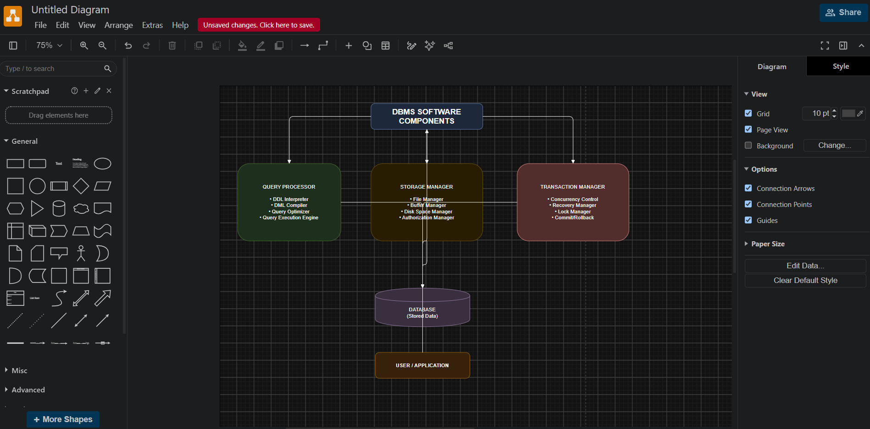

Slide 17
5.PREPARE A PRESENTATION COMPARING STRONG AND WEAK ENTITIES IN ER MODELING WITH REAL-WORLD EXAMPLES.
An entity represents a real-world object, person, place, or thing in a database.
ER modeling classifies entities into Strong Entities and Weak Entities.
A Strong Entity has its own primary key and can exist independently.
A Weak Entity does not have a complete primary key and depends on a strong entity for identification.
Strong and weak entities help represent real-world relationships more accurately

Slide 18
Strong Entity
Characteristics
Has its own primary key.
Exists independently.
Represented by a single rectangle.
Does not depend on another entity.
Examples
Student
Employee
Book
Customer

Slide 19
Weak Entity
Characteristics
Has no complete primary key.
Depends on a strong entity.
Uses a partial key.
Represented by a double rectangle.
Connected using an identifying relationship.
Examples
Employee → Dependent
Order → Order Item
Library Member → Loan Record

Slide 20
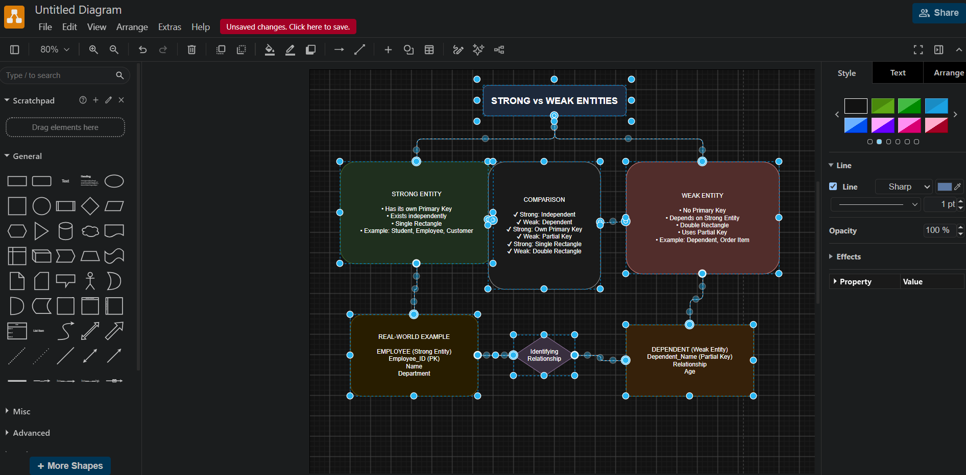
ER Diagram

Slide 21
THANK YOU

